Slide 1
Null Object Design Pattern

Slide 2
Problem
A reference hold by an object may be null
When the dependency is null, “do nothing” operations must be provided
The missing dependency case must be treated transparently

Slide 3
Description
Behavioral Design Pattern
Encapsulates the absence of an object by providing an alternative that provides suitable do nothing behavior
Use when:
An object requires a collaborator
Some collaboration instances should do nothing
Want to abstract the handling of null away from the client

Slide 4
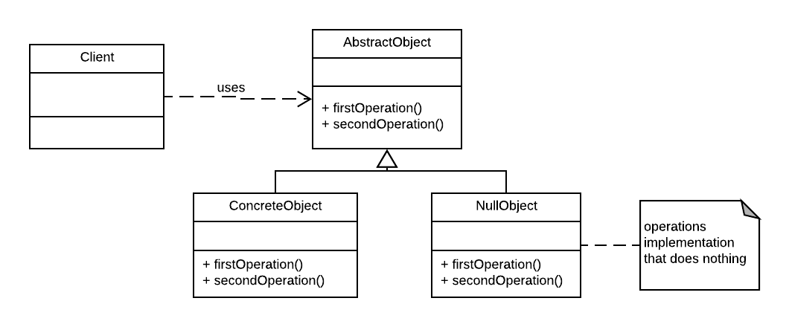
Structure

Slide 5
Structure
Client
Requires a collaborator

Slide 6
Structure
Abstract Object
declares the interface for Client's collaborator
implements default behavior for the interface common to all classes

Slide 7
Structure
ConcreteObject
defines a concrete subclass of AbstractObject whose instances provide useful behavior

Slide 8
Structure
NullObject
provides an interface identical to AbstractObject's so that a null object can be substituted for a real object
implements its interface to do nothing

Slide 9
Example
public abstract class AbstractCounter{ private int content = 0; public abstract void incrementContent(); public abstract void decrementContent(); public int getContent(){ return content; } public void setContent(int content){ this.content = content; } }

Slide 10
Example
public class CounterModuloFive extends AbstractCounter{ @Override public void setContent(int content){ if(content < 0) super.setContent(0); else if(content >= 5) super.setContent(5); else super.setContent(content); } @Override public void incrementContent(){ setContent(getContent() + 1); if(getContent() == 5) setContent(0); } @Override public void decrementContent(){ setContent(getContent() - 1); if (getContent() < 0) setContent(4); } }

Slide 11
Example
public class NullCounter extends AbstractCounter { @Override public void incrementContent() { } @Override public void decrementContent() { } @Override public void setContent(int content){ } @Override public int getContent(){ return 0; } }

Slide 12
Example
public class CounterFactory { private final static String COUNTER_MOD_FIVE_NAME = "Modulo Five"; private static CounterFactory instance; private CounterFactory(){} public static CounterFactory getInstance(){ if(instance == null) instance = new CounterFactory(); return instance; } public AbstractCounter getCounter(String name){ if(name.equals(COUNTER_MOD_FIVE_NAME)) return new CounterModuloFive(); return new NullCounter(); } }

Slide 13
Example
public static void main(String[] args){ if(args.length != 2){ System.out.println("Not enough parameters"); return; } AbstractCounter counter = CounterFactory.getInstance().getCounter(args[1]); counter.incrementContent(); counter.decrementContent(); counter.decrementContent(); System.out.println("Counter content: " + counter.getContent()); }

